Slide 1



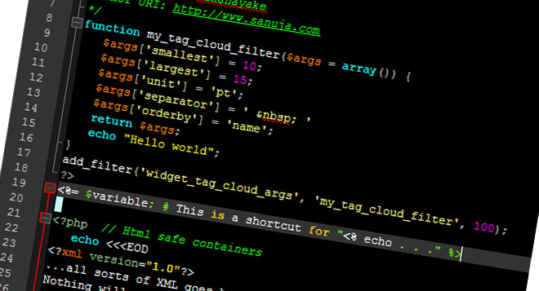

Object-Oriented
Programming in PHP
Classes, Class Members, OOP Principles and Practices in PHP
Svetlin Nakov
Technical Trainer
www.nakov.com
Software University
http://softuni.bg

Slide 2

Table of Contents
Classes in PHP
Fields, Methods, Constructors, Constants, Access Modifiers, Encapsulation, Static Members
Interfaces and Abstract Classes
Inheritance and Polymorphism
Traits
Namespaces, Enumerations
Error Levels, Exceptions
Functional Programming

Slide 3
Classes in PHP
Fields
class Laptop {
private $model;
private $price;
public function __construct($model, $price) { $this->model = $model;
$this->price = $price; }
public function __toString() {
return $this->model . " - " . $this->price . "lv.";
}
}
$laptop = new Laptop("Thinkpad T60", 320);
echo $laptop;
Constructor
Method
$this-> points to instance members

Slide 4
Constructors in PHP
Declared using the magic method __construct()
Automatically called when the object is initialized
Multiple constructors are not supported
Functions in PHP cannot be overloaded
Parent constructor is called using parent::__construct(…); inside function declaration
function __construct($name, $age, $weight) {
$this->name = $name;
$this->age = $age;
$this->weight = $weight;
}

Slide 5
Constructors – Example
class GameObject {
private $id;
function __construct($id) { $this->id= $id;
}
}
class Player extends GameObject {
private $name;
function __construct($id, $name) {
parent::__construct($id);
$this->name = $name;
}
}
Child class calls parent constructor

Slide 6
Access Modifiers
Access modifiers restrict the visibility of the class members
public – accessible from any class (default)
protected – accessible from the class itself and all its descendent classes
private – accessible from the class itself only
private $accountHolder;
private $balance;
public function __construct($accountHolder, $balance) { … }
protected function accrueInterest($percent) { … }

Slide 7
Encapsulation
Several ways of encapsulating class members in PHP:
Defining a separate getter and setter for each property:
private $balance;
function setBalance($newBalance) {
if ($newBalance >= 0) {
$this->balance = $newBalance;
} else {
trigger_error("Invalid balance");
}
}
function getBalance() {
return $this->balance;
}
Validates and sets the new value

Slide 8
Encapsulation (2)
Defining an universal getter and setter for all properties:
…
public function __get($property) {
if (property_exists($this, $property)) {
return $this->$property;
}
}
public function __set($property, $value) {
if (property_exists($this, $property)) {
$this->$property = $value;
}
}
}
$myObj->name = "Asen";
echo $myObj->age;
See http://php.net/manual/en/language.oop5.overloading.php

Slide 9
Functions
Functions in PHP:
Use camelCase naming
Can be passed to other functions as arguments (callbacks)
$array = array(2, 9, 3, 6, 2, 1);
usort($array, "compareIntegers");
function compareIntegers($intA, $intB) {
if ($intA == $intB) {
return 0;
}
return $intA > $intB ? 1 : -1;
}

Slide 10
Functions as Class Members
Functions can be class members and can access $this
class Laptop {
private $model;
private $price;
public function __construct($model, $price) {
$this->setModel($model);
$this->setPrice($price);
}
function calcDiscount($percentage) {
return $this->$price * $percentage / 100;
}
}

Slide 11
Static Members
PHP supports static class members
Declared using the static keyword
Accessed within the class with self:: / static::
class TransactionManager {
private static $transactions = new Array();
…
static function getTransaction($index) {
return self::$transactions[$index];
}
}
TransactionManager::getTransaction(4);

Slide 12
Constants
PHP supports two types of constant syntax
define($name, $value) – used outside class declaration
const – used inside a class declaration (declared static by default)
Constants are named in ALL_CAPS casing
define('MESSAGE_TIMEOUT', 400);
class Message {
const MESSAGE_TIMEOUT = 400;
…
}

Slide 13
Interfaces
Interfaces in PHP:
Define the functions a class should implement
Can also hold constants
Implemented using the implements keyword
Can extend other interfaces
interface iCollection {
function iterate();
}
interface iList extends iCollection {
function add();
}

Slide 14
Implementing an Interface – Example
interface iResizable {
function resize($x, $y);
}
class Shape implements iResizable {
private $x;
private $y;
function __construct() {
$this->x = $x;
$this->y = $y;
}
function resize($rX, $rY) {
$this->x += $rX;
$this->y += $rY;
}
}

Slide 15
Abstract Classes
Abstract classes:
Define abstract functions with no body
Cannot be instantiated
Descendant classes must implement the abstract functions
abstract class Employee {
abstract function getAccessLevel();
}
class SalesEmployee extends Employee {
function getAccessLevel() {
return AccessLevel::None;
}
}

Slide 16
Inheritance
class Animal {
private $name;
private $age;
function __construct($name, $age) {
$this->name = $name;
$this->age = $age;
}
}
class Dog extends Animal {
private $owner;
function __construct($name, $age, $owner) {
parent::__construct($name, $age);
$this->owner = $owner;
}
}

Slide 17
Virtual Methods
In PHP all class methods are virtual (unless declared final)
Can be overriden by child classes
class Shape {
…
public function rotate() {
…
}
public final move() {
…
}
}
Can be overridden
Cannot be overridden

Slide 18
Polymorphism
abstract class Mammal {
public function feed() {
…
}
}
class Dolphin extends Mammal {
}
class Human extends Mammal {
}
$mammals = Array(new Dolphin(), new Human(), new Human());
foreach ($mammals as $mammal) {
$mammal->feed();
}

Slide 19
Type Hinting
Forces method parameters to be of a certain class / interface
All subclasses / subinterfaces are also allowed
Works for classes, interfaces, arrays and callbacks (in PHP > 5.0)
Throws a fatal error if the types do not match
function render(Shape $shape) {
echo "Rendering the shape …";
}
$triangle = new Triangle();
render($triangle);

Slide 20
Checking Object Type
Object type can be checked using the instanceof operator
Useful for ensuring the wrong class member will not be called
function takeAction(Person $person) {
if ($person instanceof Student) {
$person->learn();
} else if ($person instanceof Trainer) {
$person->train();
}
}

Slide 21
Traits
Traits are groups of methods that can be injected in a class
Like interfaces but provide implemented functions, instead of function definitions
trait TalkTrait {
public function sayHello() {
echo "Hello!";
}
public function sayGoodbye() {
echo "Goodbye!";
}
}

Slide 22
Using Traits
Implemented with use inside class declaration
Implementing class and its children have access to trait methods
class Character {
use TalkTrait;
…
}
$character = new Character;
$character->sayHello(); // function coming from TalkTrait
$character->sayGoodbye(); // function coming from TalkTrait

Slide 23
Enumerations
PHP has no native enumerations
Possible workaround is declaring a set of constants in a class
class Month { const January = 1; const February = 2; const March = 3;
…
}
$currMonth = Month::March;
if ($currMonth < Month::March && $currMonth > Month::October) {
echo "Damn it's cold!";
}

Slide 24
Namespaces
Namespaces group code (classes, interfaces, functions, etc.) around a particular functionality (supported in PHP > 5.3)
Declared before any other code in the file:
Accessing a namespace from another file:
namespace Calculations;
function getCurrentInterest() {…}
…
use Calculations;
$interest = Calculations\getCurrentInterest();

Slide 25
Namespaces – Example
namespace SoftUni;
function getTopStudent() {
return "Pesho";
}
File: Softuni.php
namespace NASA;
include_once('Softuni.php');
use SoftUni;
$topSoftUniStudent = SoftUni\getTopStudent();
echo $topSoftUniStudent; // Pesho
File: NASA.php
Function call from SoftUni namespace

Slide 26
Exception Handling
PHP supports the try-catch-finally exception handling
function divide($a, $b) {
if ($b == 0) {
throw new Exception("Division by zero is not allowed!");
}
return $a / $b;
}
try {
divide(4, 0);
} catch (Exception $e) {
echo $e->getMessage();
}

Slide 27
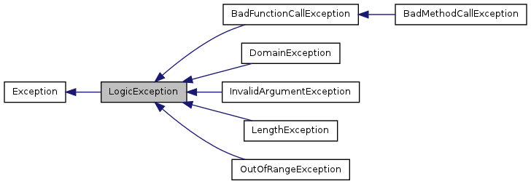
Exceptions Hierarchy in PHP
Exceptions hierarchy in Standard PHP Library (SPL):

Slide 28
Creating Custom Exceptions
class ENullArgumentException extends Exception {
public function __construct() {
parent::__construct("Argument cannot be null.", 101);
}
}
class Customer {
function setName($name) {
if ($name == null) throw new ENullArgumentException();
else $this->name = $name;
}
}
try {
$customer = new Customer();
$customer->setName("Gosho");
} catch (ENullArgumentException $e) {
echo $e->getMessage() . " / code: " . $e->getCode();
}

Slide 29
Global Exception Handler
set_exception_handler($callback)
Executes $callback each time an exception is not handled
All uncaught exceptions are sent to this function
set_exception_handler('ex_handler');
function ex_handler($e) {
echo $e->getMessage() . " on line " . $e->getLine();
}
…
throw new Exception("Random exception");

Slide 30
Auto Loading Classes
The magic __autoload() function attempts to load a class
class MyClass {
public function __construct() {
echo "MyClass constructor called.";
}
}
./MyClass.class.php
function __autoload($className) {
include_once("./" . $className . ".class.php");
}
…
$obj = new MyClass(); // This will autoload MyClass.class.php
./index.php

Slide 31
Standard PHP Library (SPL)
PHP has its standard library called SPL (Standard PHP Library)
Defines common collection interfaces
Defines some data structures like stacks, queue, heap, …
Defines iterators for arrays, directories, …
Defines standard exceptions class hierarchy
Defines standard autoload mechanism
Learn more about SPL at:
http://php.net/manual/en/book.spl.php

Slide 32
SPL Auto Load
We can auto-load classes from PHP files the following way:
define('CLASS_DIR', 'class/')
set_include_path(get_include_path().PATH_SEPARATOR.CLASS_DIR);
spl_autoload_extensions('.class.php');
spl_autoload_register();
// This will load the file class/MyProject/Data/Student.class.php
spl_autoload('\MyProject\Data\Student');

Slide 33
Functional Programming
PHP provides several built-in array functions
Take array and callback (anonymous function) as arguments
Implement filtering and mapping in partially functional style:
$numbers = array(6, 7, 9, 10, 12, 4, 2);
$evenNumbers = array_filter($array, function($n) {
return $n % 2 == 0;
});
$squareNumbers = array_map(function($n) {
return $n * $n;
}, $evenNumbers);

Slide 34

Summary
PHP supports OOP: classes, fields, properties, methods, access modifiers, encapsulation, constructors, constants, static members, etc.
PHP supports interfaces and abstract classes
PHP supports inheritance and polymorphism
PHP supports traits: injecting a set of methods
PHP supports classical exception handling
PHP supports anonymous functions (callbacks)

Slide 35
OOP in PHP
https://softuni.bg/trainings/coursesinstances/details/8

Slide 36
License
This course (slides, examples, demos, videos, homework, etc.) is licensed under the "Creative Commons Attribution-NonCommercial-ShareAlike 4.0 International" license
Attribution: this work may contain portions from
"OOP" course by Telerik Academy under CC-BY-NC-SA license

Slide 37







SoftUni Diamond Partners

Slide 38





Free Trainings @ Software University
Software University Foundation – softuni.org
Software University – High-Quality Education, Profession and Job for Software Developers
softuni.bg
Software University @ Facebook
facebook.com/SoftwareUniversity
Software University @ YouTube
youtube.com/SoftwareUniversity
Software University Forums – forum.softuni.bg

